Slide 1

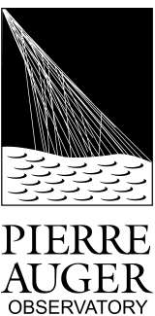
Measurement of the Number of Muons in Inclined Showers
M. Oliveira, L. Cazon, R. Conceição, M. Pimenta
2nd MARTA Progress Meeting
19th October 2012
μ

Slide 2

Outline
Reconstruction Method
EM contamination
Calibration
Bias and Resolution
Application to Data
Conclusions and Prospects

Slide 3
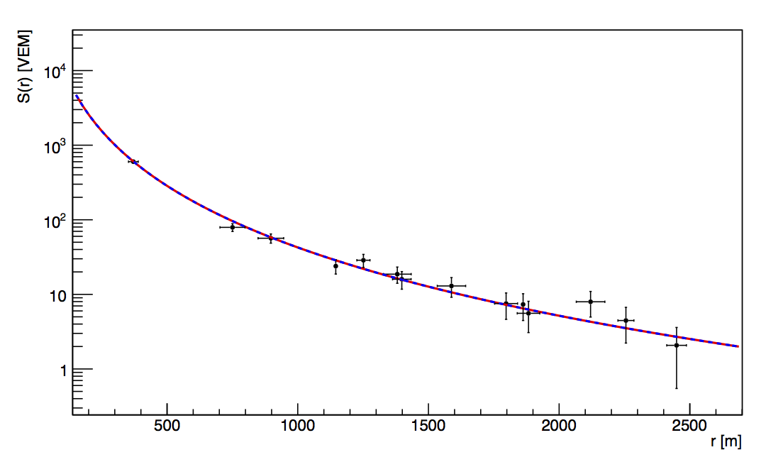
Reconstruction Method
Method to recover the number of muons on the ground from the LDF
Signal as a function of r the distance to the shower core in the perpendicular plane
Signal on the ground is due to various components:
At theta=60 the EM component is small, the signal in the tanks is dominated by muons
Muons give signals proportional to their tracks
The muonic signal in the tanks can be expressed as:
NKG:

Slide 4
Reconstruction Method
Averaging the Signal:
And from the projected area:
Finally we get the number of muons on the ground from the Signal:
Number of muons from the fit to the signal sampled by the SD

Slide 5
Simulations
The integral of the LDF will be evaluated for various r-cuts
Assess the best r-cuts for the resolution and bias
Good separation between the Proton and Iron muon distributions
50 Shower Simulations with CORSIKA for proton and iron Qgsjet-II.03
Energy = 10^{18.6} – 10^{19.5} eV
Theta = 60°
random Phi
5 different realizations for each CORSIKA simulation
Total of 250 Reconstructed events for Proton and Iron
N_{μ} TRUE: Number of Muons obtained from the CORSIKA simulated files
N_{μ} REC: Number of Muons obtained from our reconstruction using the LDF

Slide 6
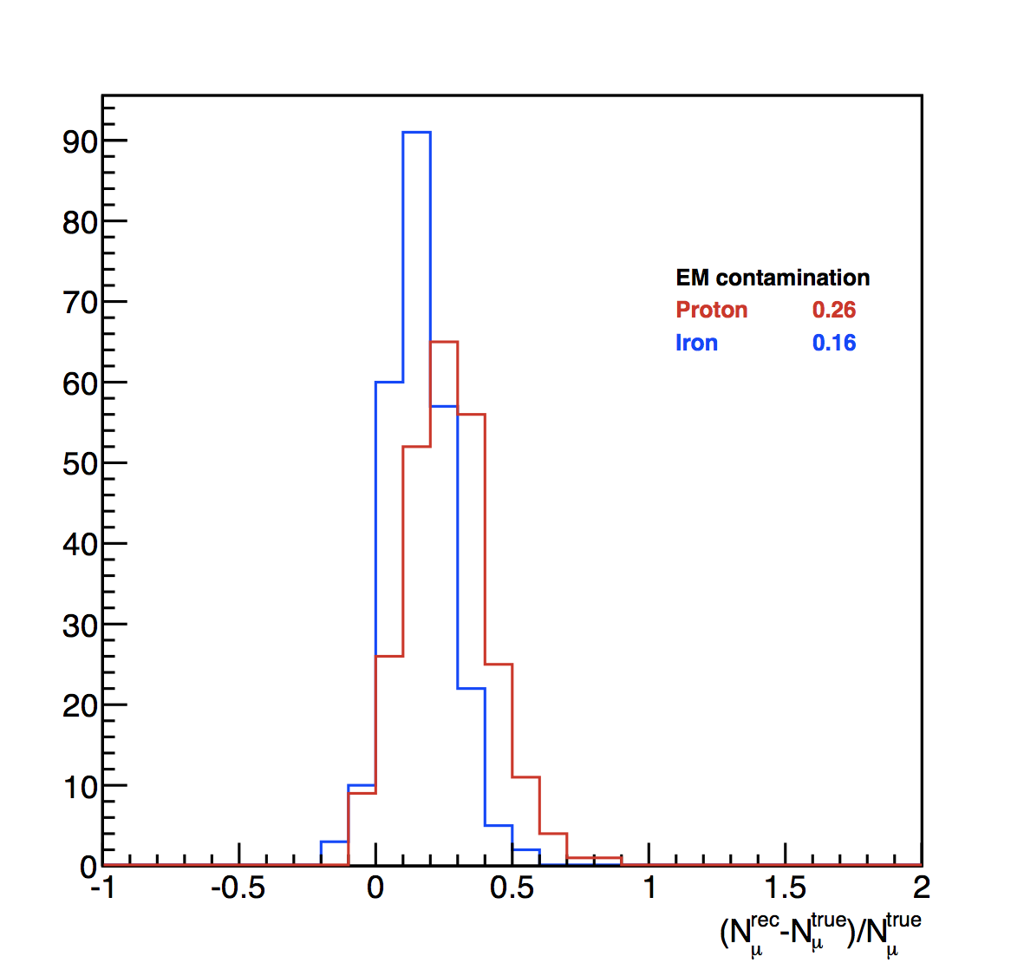
Signal Contamination
Electromagnetic halo decreases with the distance to the shower core
The method considers all the signal in the stations, EM halo included
Need for a Calibration in order to attenuate the electromagnetic halo
EM contamination: 15% - 30%
Depends on Primary Energy
Depends on zenith angle

Slide 7
Calibration
Fit to N_{μ}(Rec) vs N_{μ}(True) to get parameters in order to attenuate the EM component.
Calibration relative to the True number of muons
Number of muons without the EM component
alpha an beta are the calibration parameters
Fit to alpha an beta in order to recover values for all energies

Slide 8
Bias & Resolution
We apply the Proton primary calibration to Proton and Iron primaries
After the calibration:
Pull Distributions give the Bias and the Resolution of the Method
Fit in order to determine the distribution for any given energy

Slide 9
Application to Data
Application to SDHASRec Data (2004-2012 except 2009)
Cuts:
Energy [E +/- 0.05]
Theta [58.5 – 61.5]
T5 Trigger
Energy | 18.6 |  | 18.8 |  | 19.0 |  | 19.2 |  | 19.4 |  | 19.5
Events | 600 |  | 261 |  | 113 |  | 47 |  | 15 |  | 5
 | Mean x10⁶ | RMS x10⁶
P | 4.96 | 1.08 | 6.72 | 1.54 | 10.2 | 1.94 | 15.6 | 2.33 | 25.0 | 4.11 | 30.9 | 5.02
Fe | 6.13 | 0.97 | 8.60 | 1.21 | 13.1 | 1.70 | 19.8 | 2.34 | 30.9 | 2.89 | 39.8 | 3.61
DATA | 9.85 | 1.17 | 15.2 | 1.56 | 23.5 | 2.23 | 37.3 | 3.35 | 56.3 | 4.20 | 69.7 | 4.78

Slide 10
Muonic Distributions
10^{18.6}
10^{18.8}
10^{19.0}
10^{19.2}
10^{19.4}
10^{19.5}

Slide 11
Elongation Rate
5
15
47
113
261
Resolution
600
β (proton) = 0.91
β (iron) = 0.91
β (data) = 0.95
Preliminary

Slide 12
Application to Data
Application to GoldenRec Data (2004-2012 except 2009)
Cuts:
Energy [E +/- 0.05]
Theta [57. – 63.]
T5 Trigger
FD HasEnergy
Energy | 18.6 |  | 18.8 |  | 19.0 |  | 19.2 |  | 19.4 |  | 19.5
Events | 168 |  | 88 |  | 48 |  | 24 |  | 14 |  | 7
 | Mean x10⁶ | RMS x10⁶
P | 4.96 | 1.08 | 6.72 | 1.54 | 10.2 | 1.94 | 15.6 | 2.33 | 25.0 | 4.11 | 30.9 | 5.02
Fe | 6.13 | 0.97 | 8.60 | 1.21 | 13.1 | 1.70 | 19.8 | 2.34 | 30.9 | 2.89 | 39.8 | 3.61
DATA | 7.75 | 3.22 | 12.6 | 5.13 | 19.2 | 10.4 | 30.1 | 11.6 | 47.5 | 8.65 | 66.9 | 11.3

Slide 13
Elongation Rate
7
14
24
48
88
168
Resolution
β (proton) = 0.91
β (iron) = 0.91
β (data) = 0.91
Preliminary

Slide 14
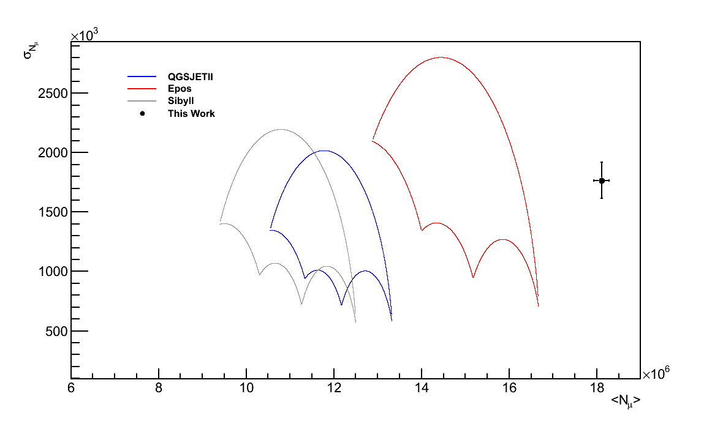
Umbrella
These parabolas define a closed contour that contain all possible combinations of mass mixtures for A[1-56]
E = 10¹⁹eV
Two first momenta of the distribution N_{μ} and RMS(N_{μ})
The result obtained is not compatible with any of the hadronic interaction models
Systematics to be included

Slide 15
Umbrella
10^{19.4}
10^{19.2}
10^{19.5}
10^{19.0}
10^{18.8}
QGSJET II
10¹⁹
10^{18.6}
Preliminary

Slide 16
Conclusions and Prospects
Encouraging preliminary results
Simple method that allows to obtain the distribution of the number of muons
Study of their shape, analysis of the momenta of the distribution
Measure more muons than the previsions of the models, in accordance with previous works
None of the models gives an accurate description of the number of muons in Auger data
Integrate the X^{μ}_{max}, obtain a better resolution
Better understanding of the hadronic models
High Precision measurements of the muonic component of the EAS, Detector Enhancements

Slide 17
Thank You!

Slide 18
BackUp!!!

Slide 19
Umbrella Plot
σN_{μ}
These parabolas define a closed contour that contain all possible combinations of mass mixtures for A[1-56]
P
50-50 mixture
He
N
Fe
Phase space allowed for all primaries
Different hadronic models have different umbrella plots
<N_{μ}>

Slide 20
Umbrella

Slide 21
Muonic Distributions

Slide 22
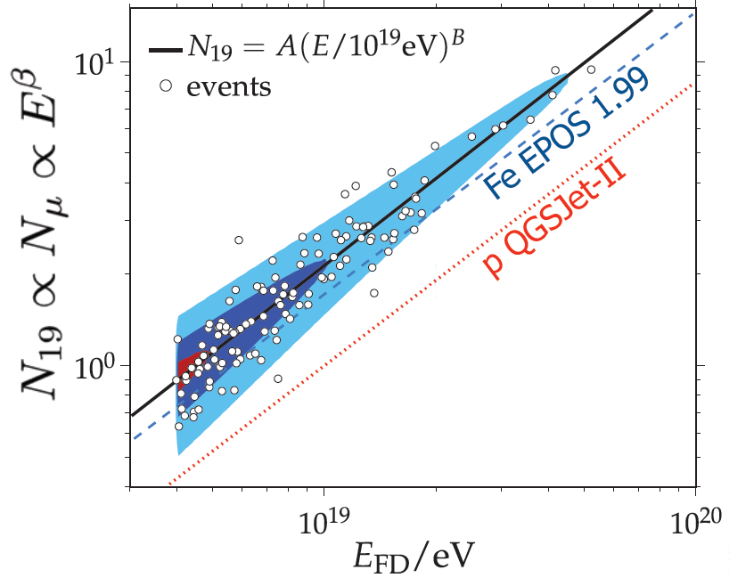
Backup
Number of muons from the auger data
Inclined showers: 62° - 80°
EM component is absorbed in the atmosphere
Signal on the ground is mainly due to muons; there is an EM component from muon decay ~20%
The integral of the signal on the ground gives the number of muons on the ground

Slide 23
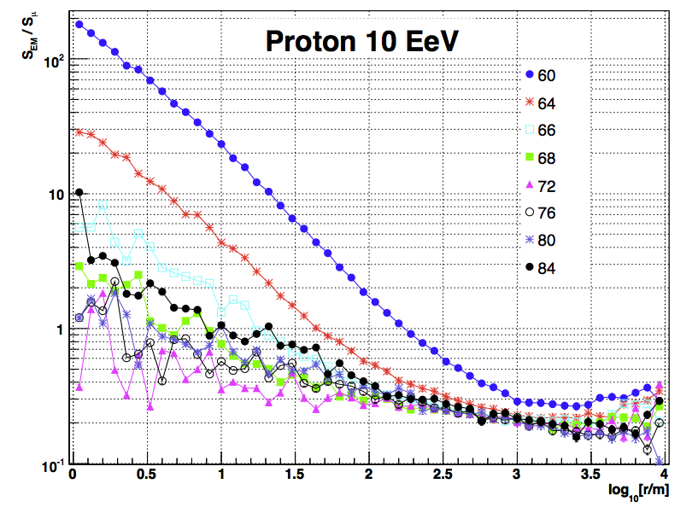
R-cut [500-2000]
Evolution of the EM contamination
Decreases with the distance to the shower core
Decreases with increasing zenith angle

Slide 24
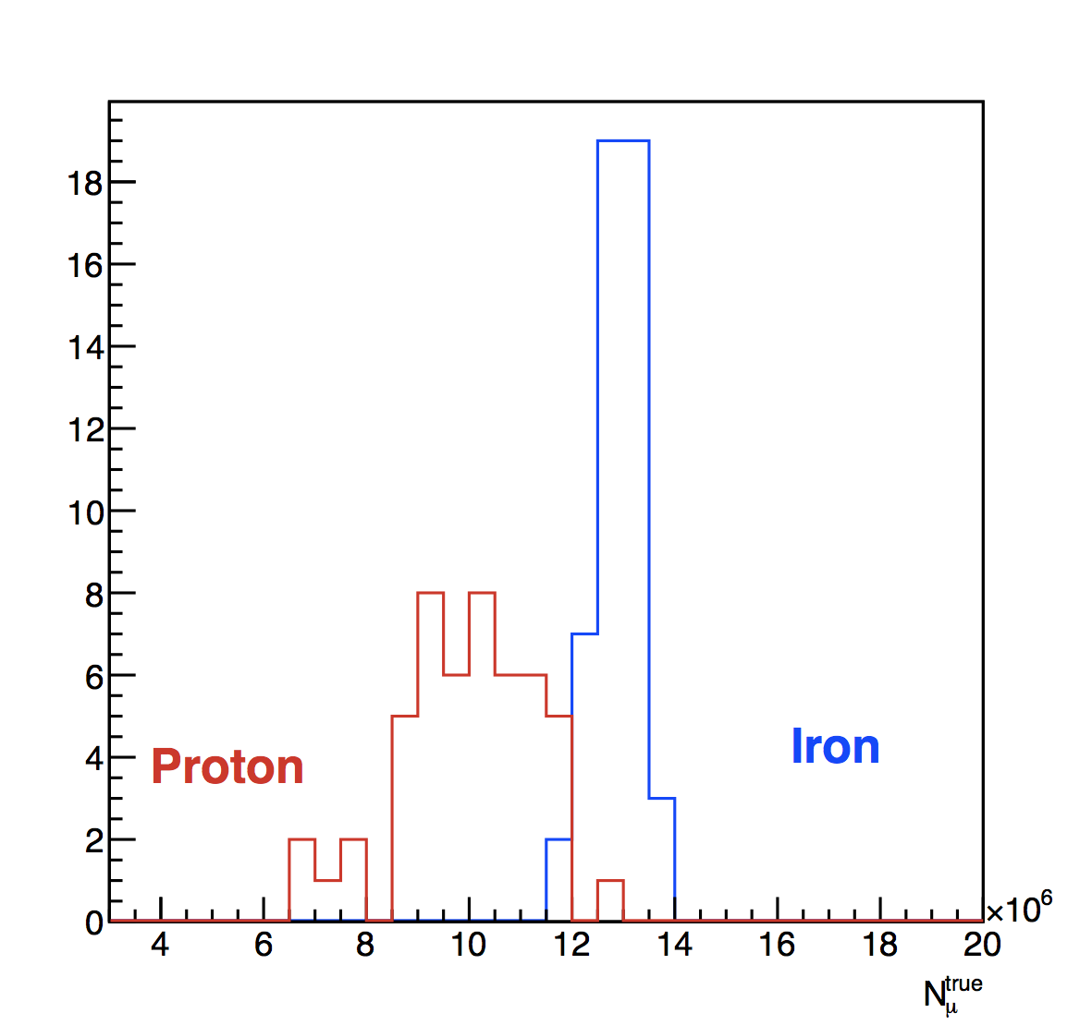
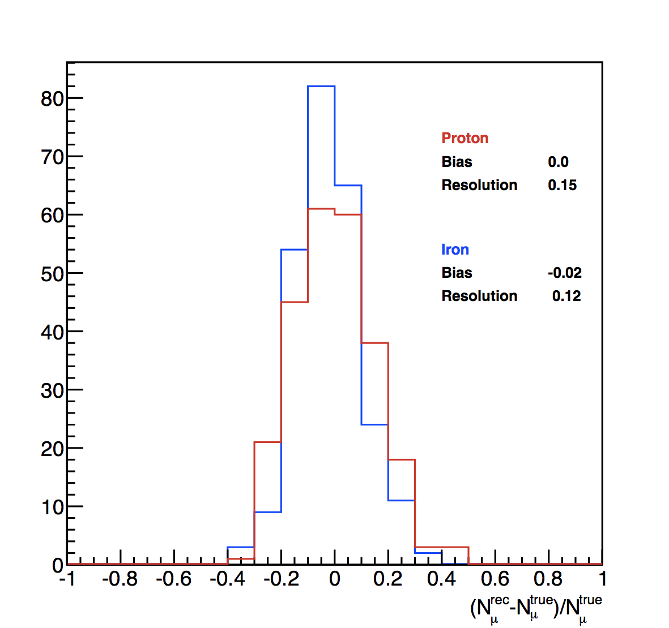
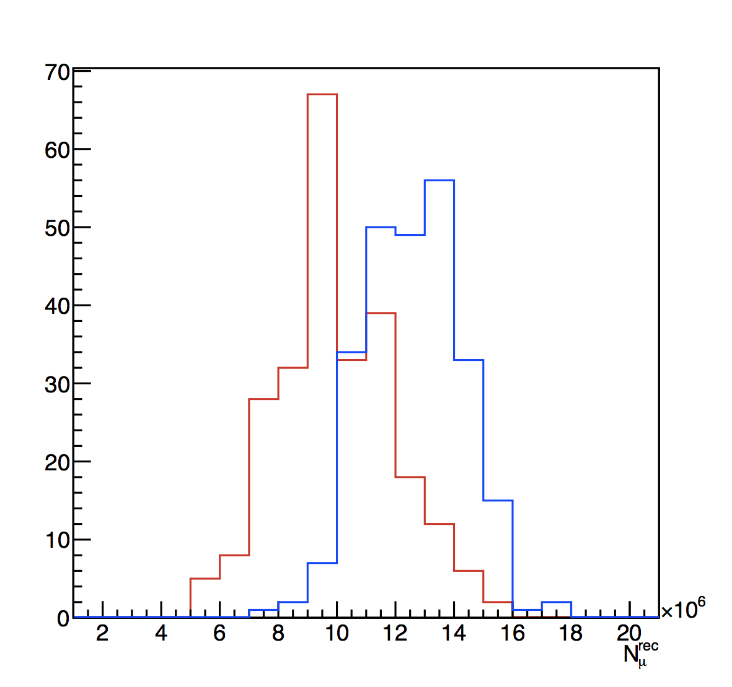
R-cut [500-2000]

Slide 25
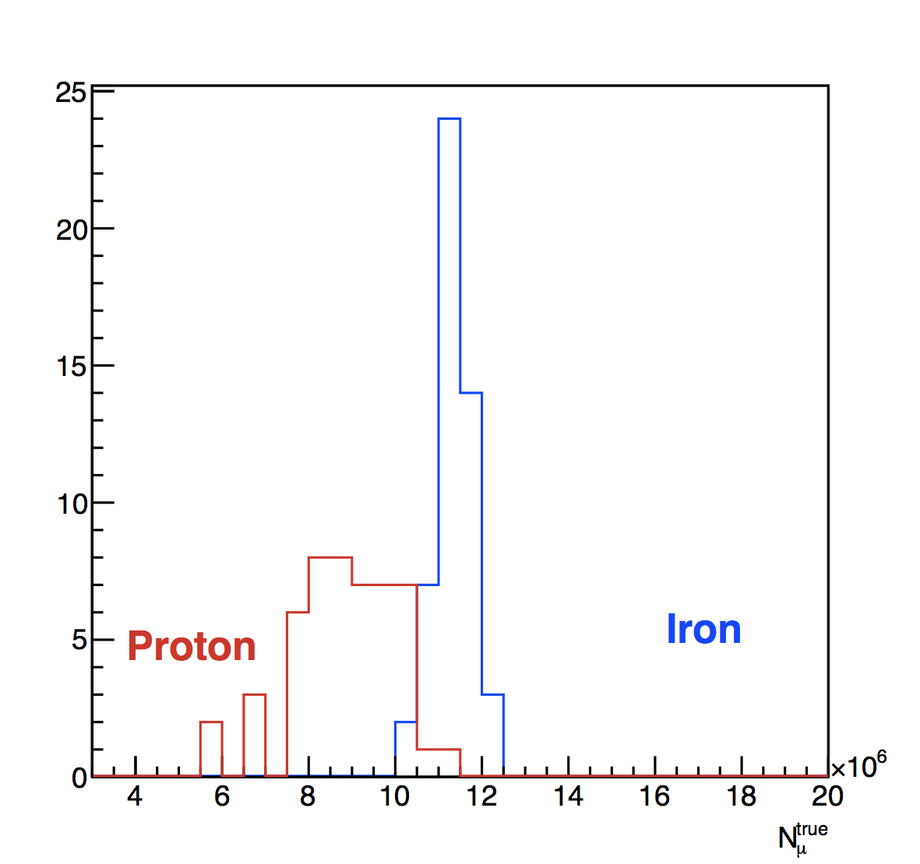
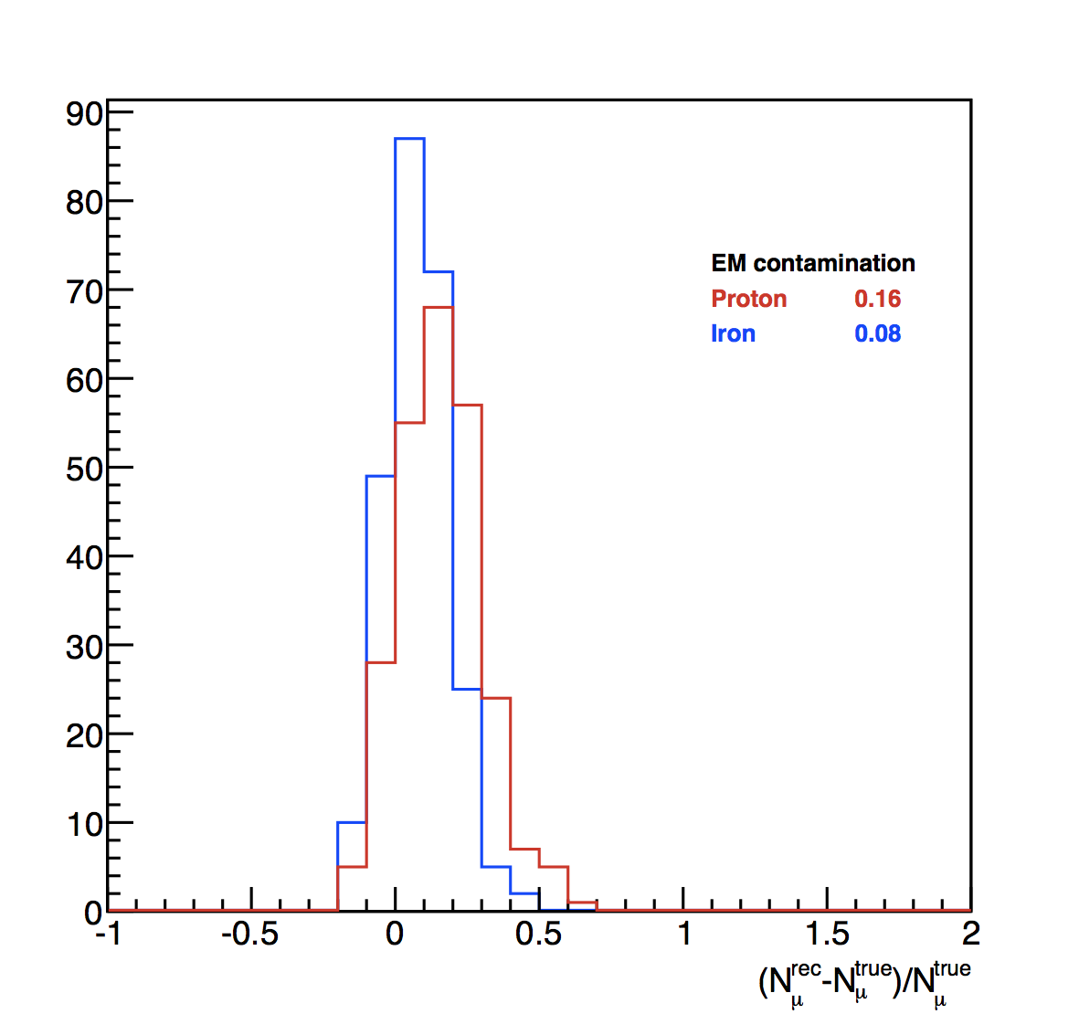
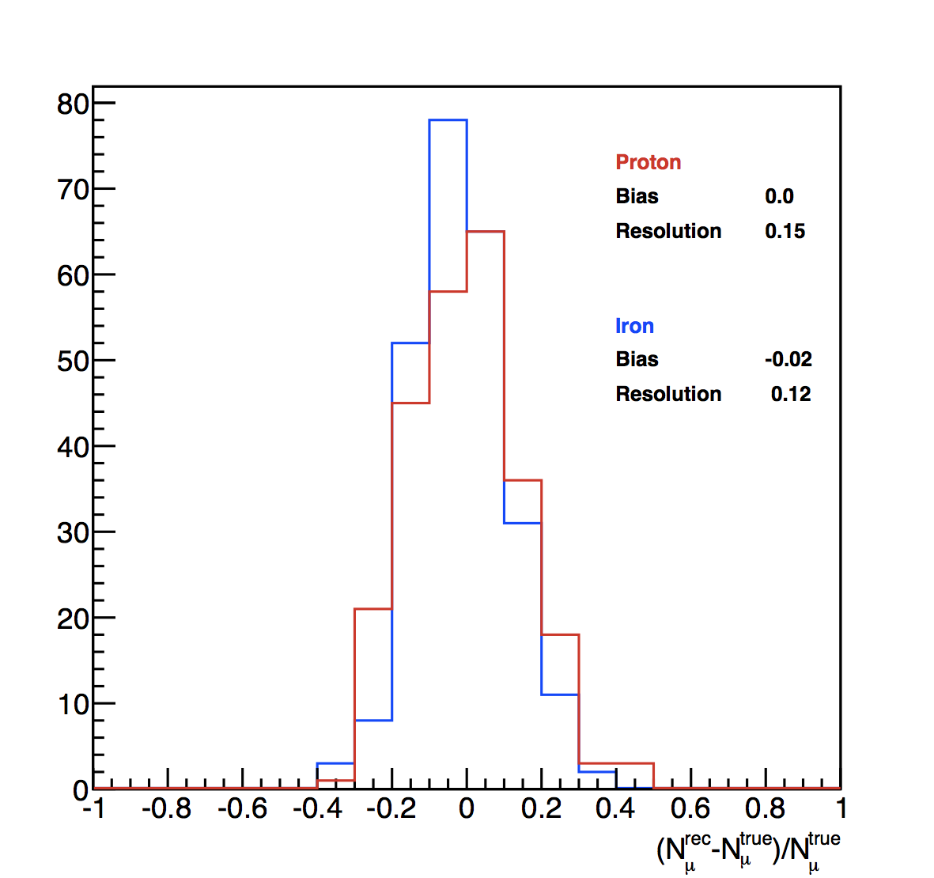
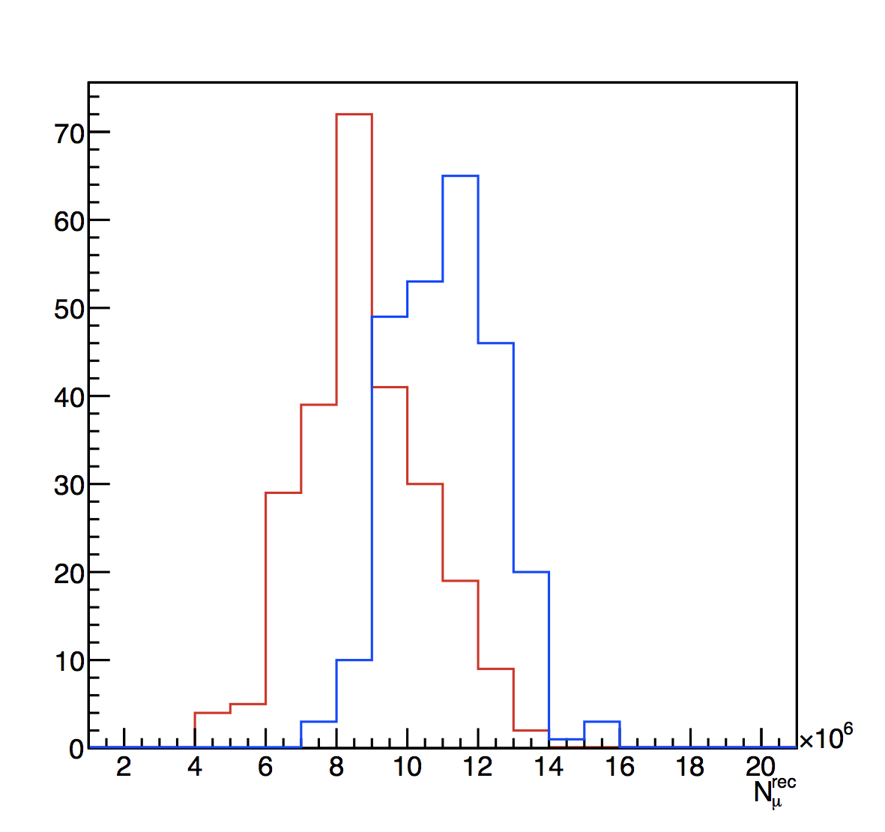
R-cut [500-1500]

